Slide 1
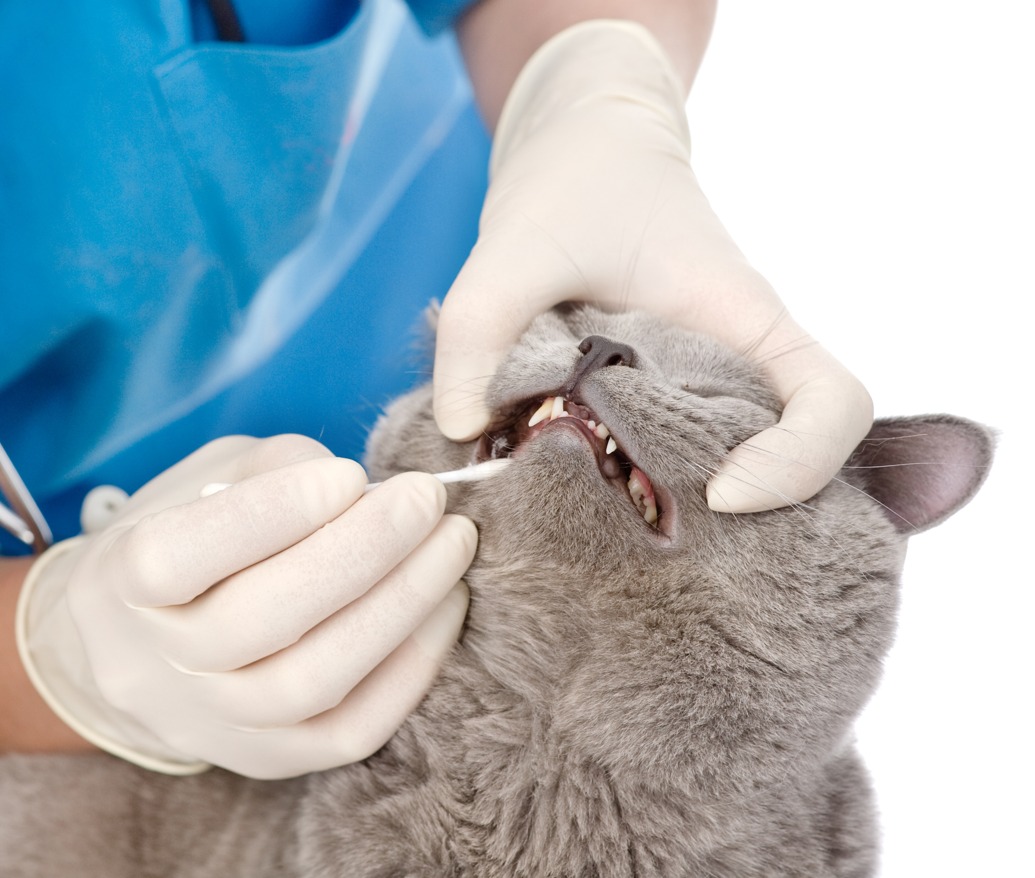
Did You Know? Oral disease could be considered to be the most common health problem seen in dogs and cats and may contribute to other health conditions such as heart disease, kidney disease and diabetes.
What is periodontal disease?
Periodontal disease is an infection of the tissue surrounding the teeth.
What causes dental disease?
A thin film of protein from saliva, food particles and dead cells form on teeth and gums.
Bacteria in the form of plaque attaches to the teeth. When that bacteria dies, the saliva calcifies it and turns it into calculus (tartar). As it progresses, it causes more and more damage to the teeth and surrounding gum tissue.
Most dental disease occurs below the gumline where it is not visible.
Notes:
For additional information and resources, visit https://www.isvma.org/pet-oral-health-page/

Slide 2
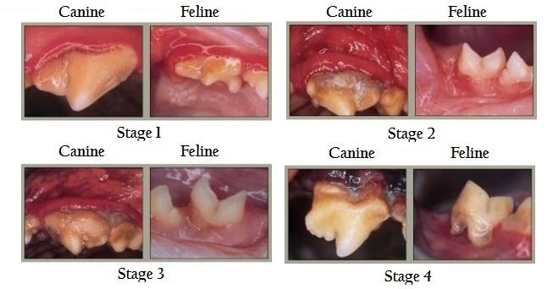
Stages of Periodontal Disease
Stages of Periodontal disease
Stage 1: Healthy mouth with normal bacterial flora, healthy gums and minimal plaque buildup.
Stage 2: Beginning stages of dental disease – you can see inflammation of the gum tissue caused by bacteria
Stage 3: Unhealthy oral cavity – gum recession, root exposure, plaque buildup. Some tooth loss probable. Mouth may start be be painful.
Stage 4: Mouth can have pus, bacteria, etc. and teeth are falling out and gums are severely inflamed and infected. Tooth roots are infected and exposed. Mouth is typically very painful.

Slide 3
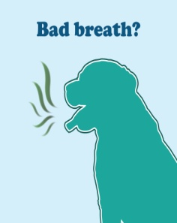
What are signs that you should have your pet’s teeth examined?
What are the signs that you should have your pet’s teeth examined?
Bad Breath
Broken/loose teeth
Extra teeth or retained baby teeth
Teeth that are covered in tartar
Abnormal chewing, drooling, or dropping food from mouth
Reduced appetite or refusal to eat
Pain in or around the mouth
Bleeding or swelling from the mouth
What your veterinarian can do to prevent dental disease
AAHA (American Animal Hospital Association) recommends regular examination (at least annually) and dental cleanings under general anesthesia.
What can you do at home for your pet’s oral healthy?
Prevention is key!
Regularly brushing your pet’s teeth is the single most effective thing you can do to keep teeth healthy between dental cleanings.
Daily brushing is best, but even several times a week can be effective
There are many products available for dental health - your veterinarian can help you decide the best dental products, treats, or dental specific diets you’re considering for your pet

Slide 4
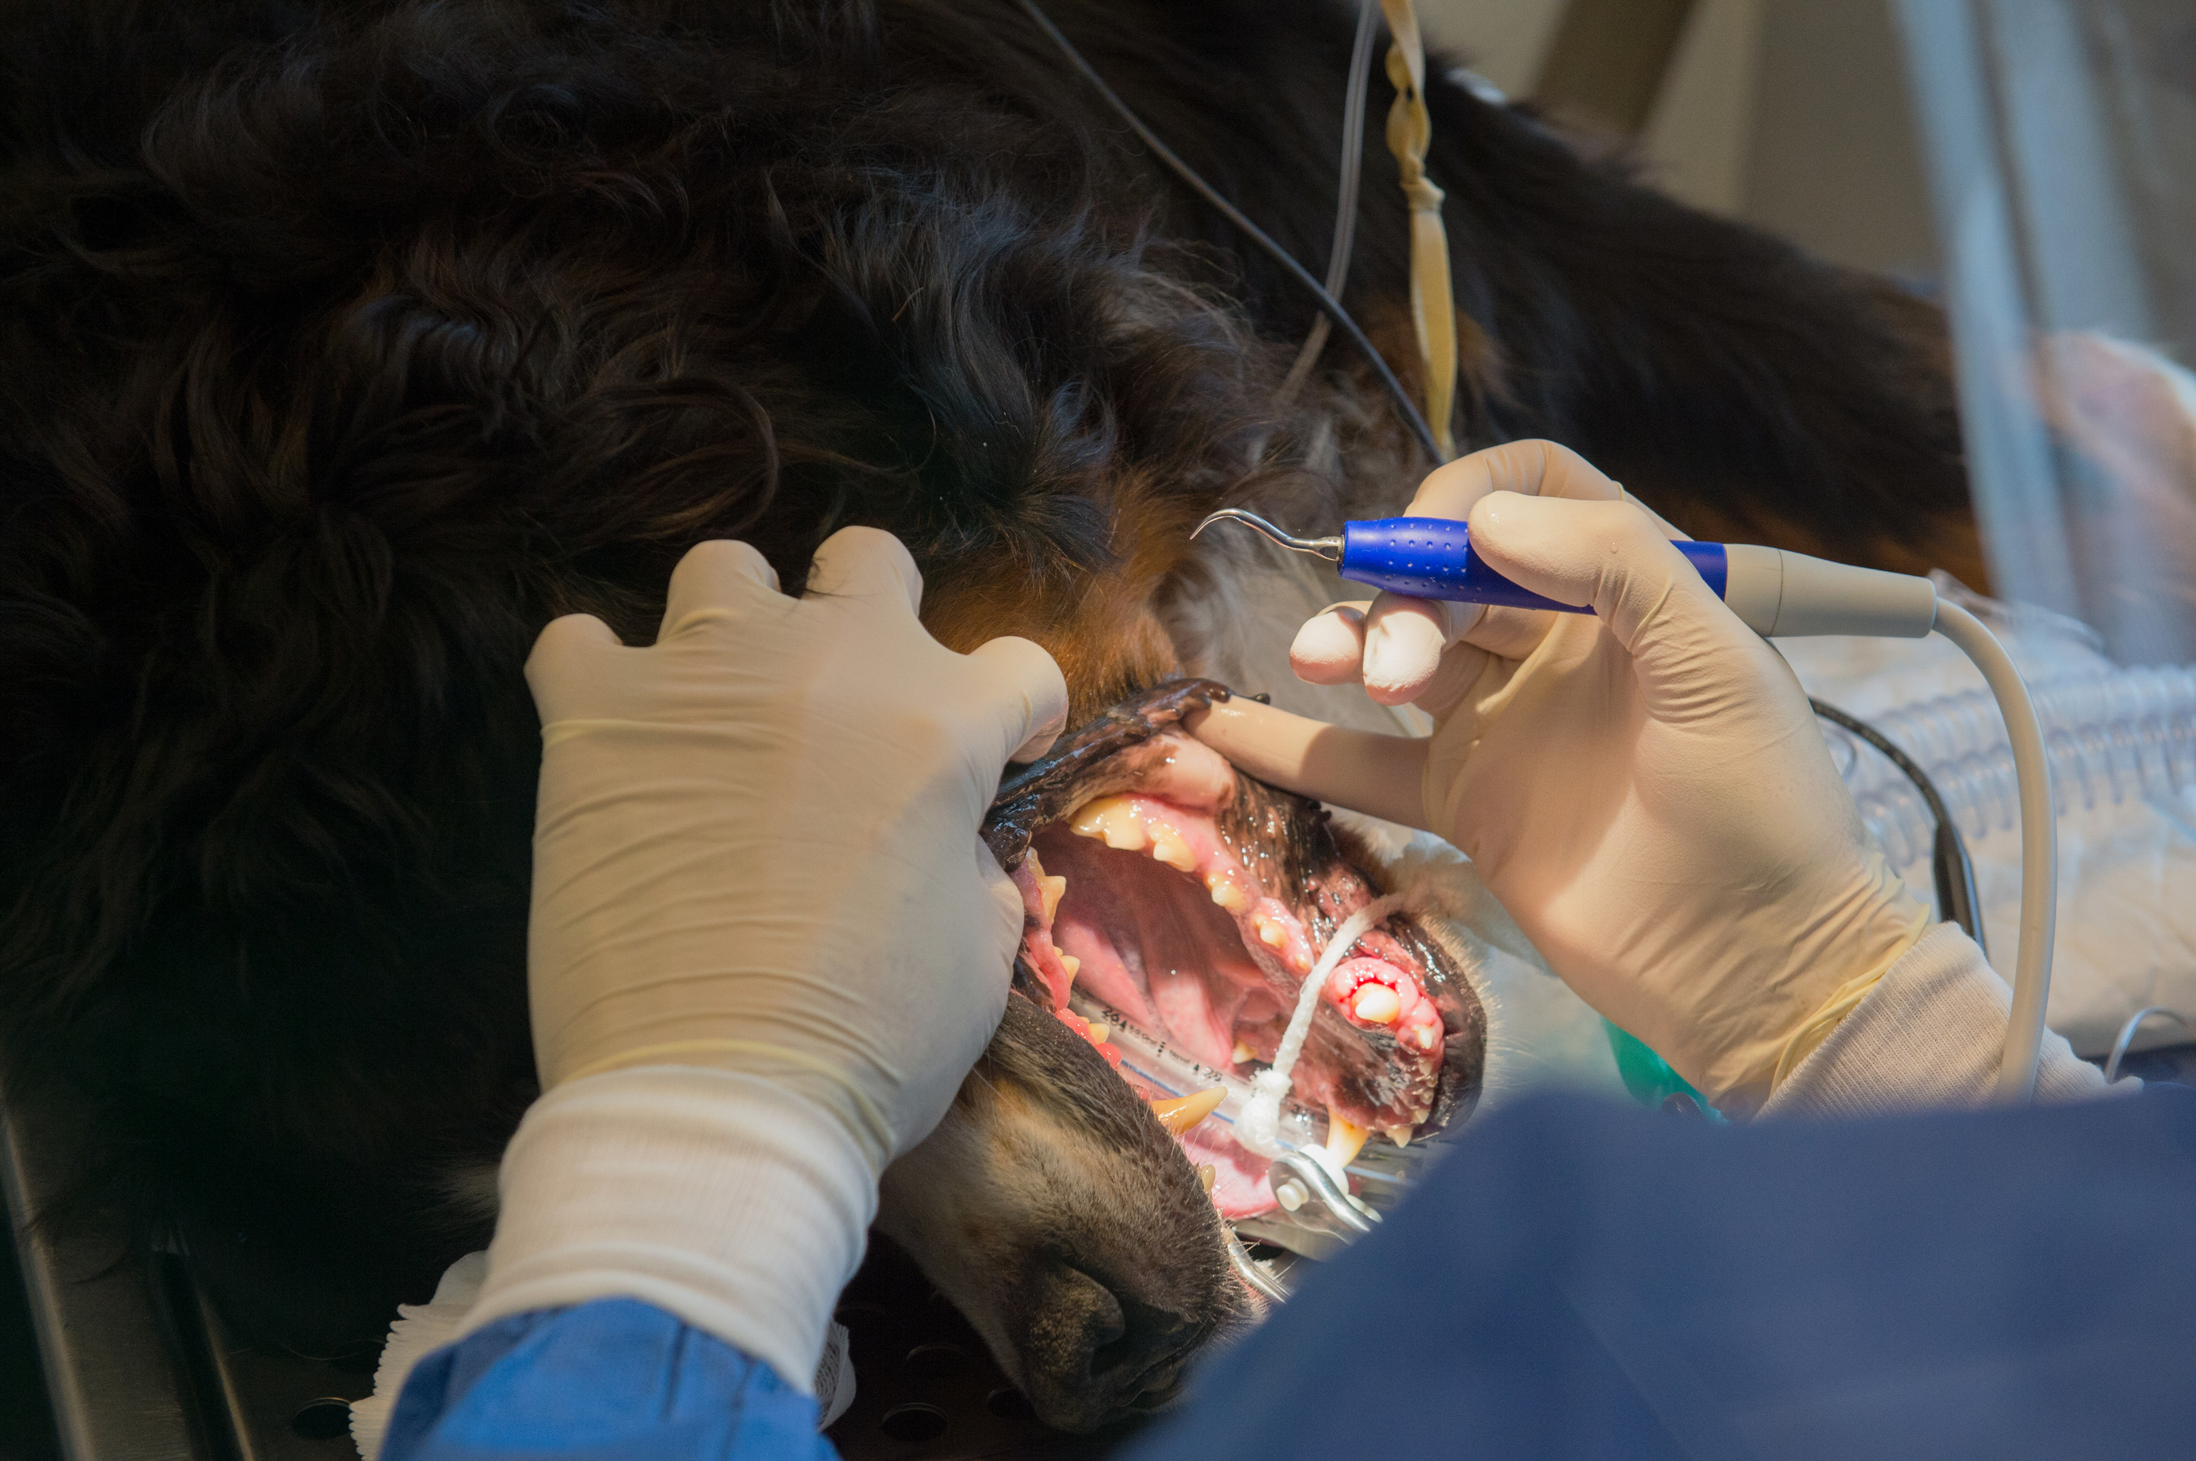
Why does dentistry require anesthesia?
Unlike humans, pets do not understand the benefit of dental procedures, and therefore will react by moving, trying to escape or even biting.
Enables veterinarians to perform dental procedures with less stress and pain for your pet.
Allows for better cleaning
Able to perform x-rays or other diagnostics if needed.

Slide 5
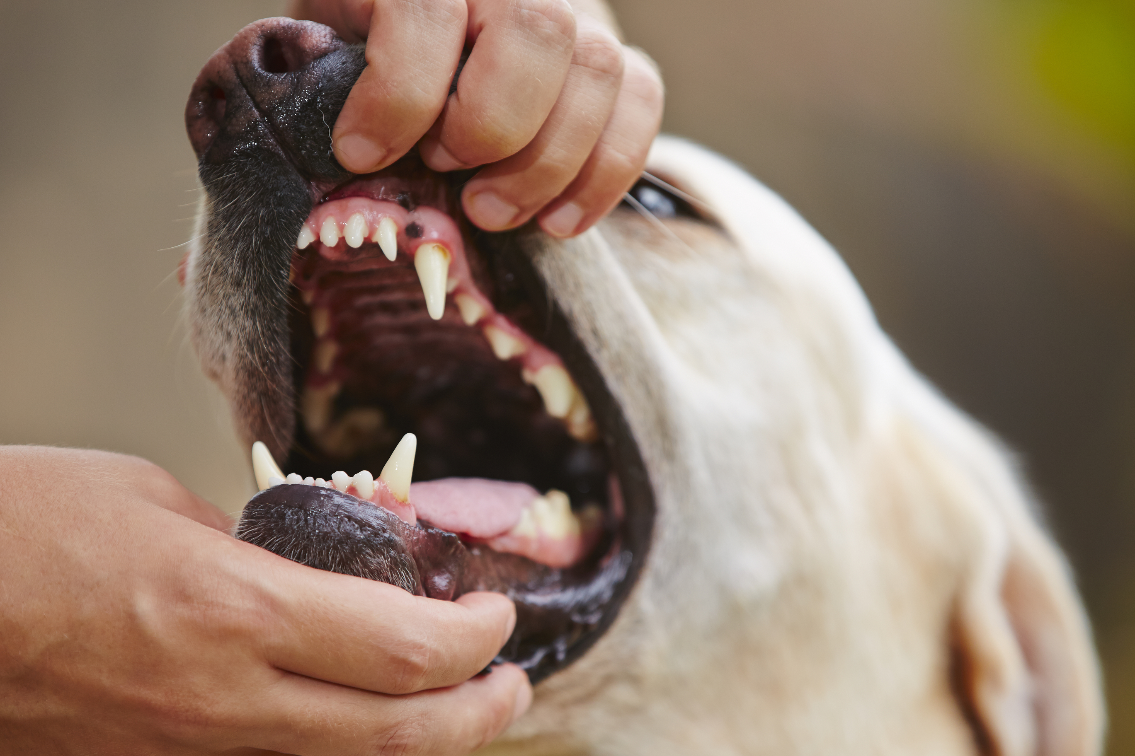
How many permanent teeth does an adult dog have? An adult cat? (Post your answer in the comments for a chance to win a gift card in a drawing of all the correct answers!)
For more information on your pet’s oral health, visit the American Veterinary Dental College (AVDC) at: http://www.avdc.org
http://www.aaha.org
Notes:
Quiz Ansers: 42 teeth for adult dog; 30 teeth for an adult cat

