Slide 1
Vaccinating your pet doesn’t just protect the animal you love…It also protects the people you love.
Things to considering when vaccinating your pet:
Rabies vaccination is REQUIRED by law. Rabies is a serious, fatal disease transmissible to humans.
Serious vaccine reactions are rare
Your vet can guide you on which vaccines your pet needs and how often they should be repeated based on your pets individual risks.
Rabies Information
AAHA Pet Owner Guidelines
Notes:
A few things to keep in mind when considering vaccinating your pet:
Rabies vaccination is REQUIRED by law. Rabies is a serious, fatal disease transmissible to humans.
Serious vaccine reactions are rare
Your vet can guide you on which vaccines your pet needs and how often they should be repeated based on your pets individual risks.
https://www.aaha.org/pet_owner/aaha_guidelines/aahas_canine_vaccination_guidelines.aspx
And also the link to your clinic page here ________

Slide 2
Why shouldn’t you vaccinate your pet yourself?
Improper storage and handling renders many vaccines useless
Giving vaccines in the wrong location or at the wrong time may be harmful to your pet
Your veterinarian can advise you on which vaccines your pet does/doesn’t need
Yearly vaccines at the veterinarian’s office are a great chance for a health check
By law, rabies vaccines must be administered by a veterinarian

Slide 3
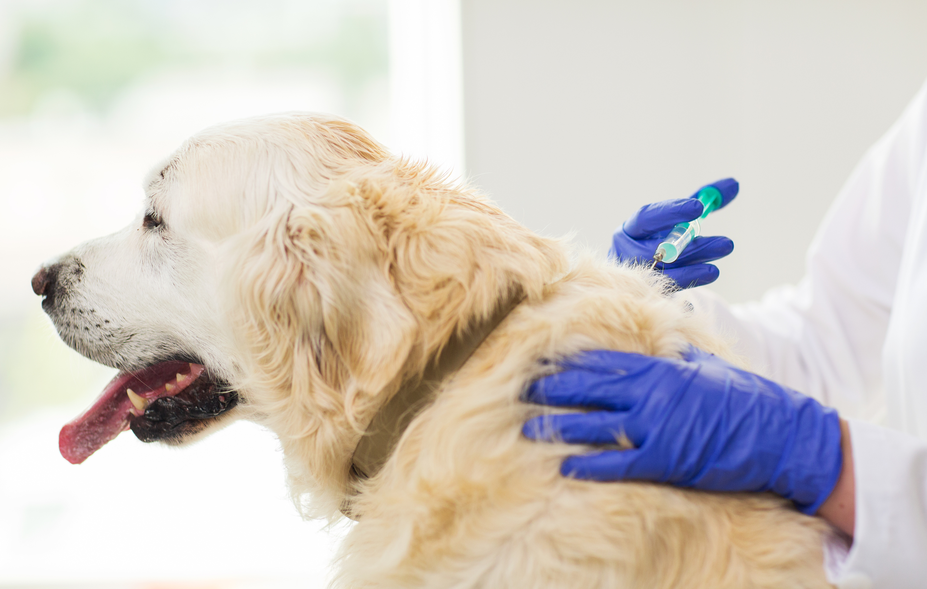
Not sure which vaccine your pet needs? Check out this life-style vaccine calculator and talk to your veterinarian! Life-style Vaccine Calculator

Slide 4
Which 4 wild animals in the U.S. are the most likely to have rabies? (Post your answer in the comments for a chance to win a gift card in a drawing of all the correct answers!)
Raccoons
Possums
Foxes
Coyotes
Skunks
Bats
Rats
Mountain Lions
Notes:
Raccoons
Foxes
Skunks
Bats
If you, a family member, or a pet is exposed to a potentially infected animal you should seek medical attention immediately. Failure to do so could be fatal. Over 40,000 people in the United States each year receive the prophylactic rabies shot due to possible exposure.

Slide 5
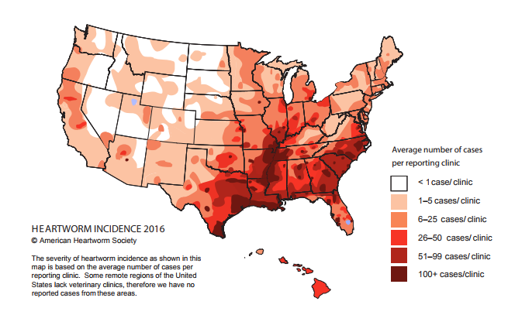
What is Heartworm Disease?
A disease that is transmitted through infected mosquitoes and causes lasting damage to the heart, lungs and arteries and can be fatal.
Over the past 10 years, Illinois has continued to increase in the incidence of Heartworm disease.

Slide 6
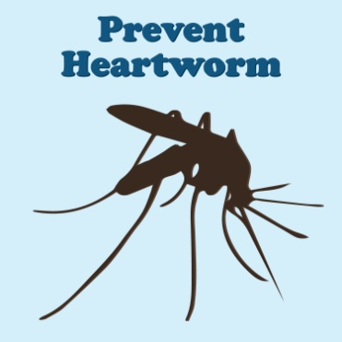
Did You Know?
Cats are susceptible to contracting heartworm disease as well, but they are considered atypical hosts.
There are many different heartworm prevention products available – your veterinarian can help you choose the best prevention for your pet. An added bonus is that most heartworm preventions also help control most of the common intestinal parasites.
Making sure your dog stays on monthly heartworm prevent ion year round is critical in preventing the disease.
The American Heartworm Society recommends annual heartworm testing in dogs to ensure that the prevention is effective. Only one missed dose can leave your pet susceptible. If your dog is younger than one year of age, discuss with your veterinarian when your when your dog needs tested

Slide 7
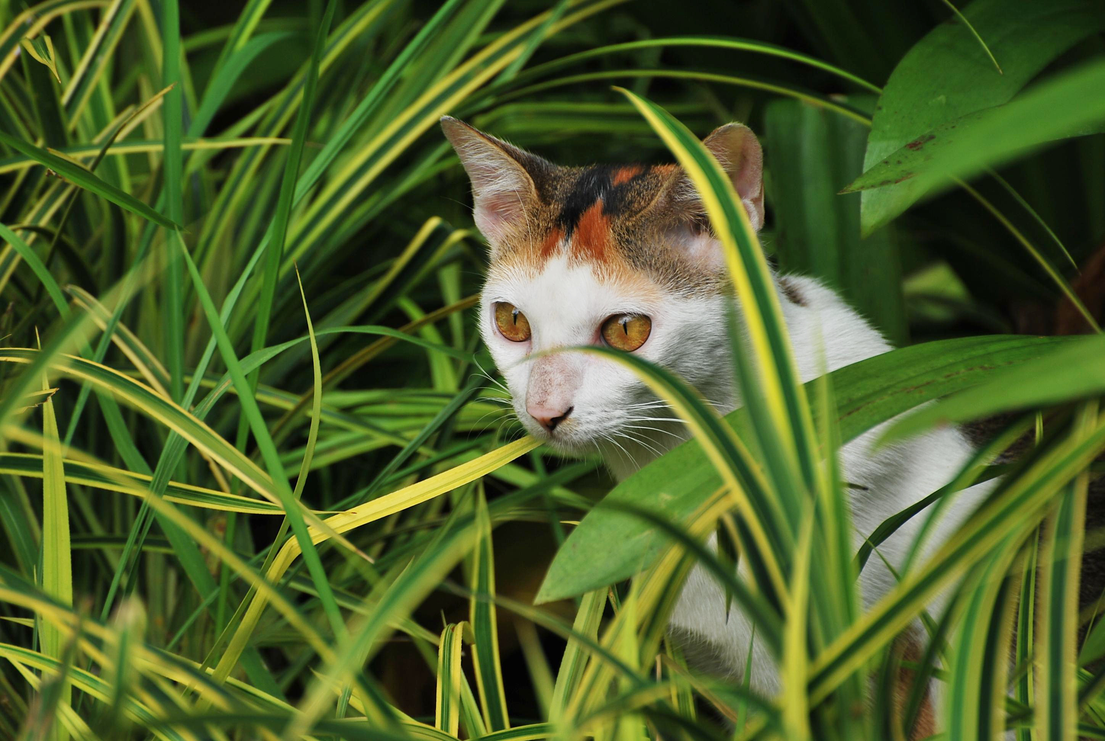
True or False?
My pet only goes outside to go potty so it isn’t at risk for contracting heartworm disease?
False. EVERY pet is at risk for contracting heartworm disease whether they go outside or not as it only takes one bite from a mosquito outside while your pet is going to the bathroom, and mosquitoes often are in the home, especially during summer months.
For more information on heartworm disease and prevention in dogs and cats, visit the American Heartworm Society at
https://www.heartwormsociety.org

