Slide 1
Why Spay or Neuter Your Pet?
Medical benefits
Helps address pet overpopulation by preventing the birth of unwanted puppies and kittens
What does a spay entail? –Removal of the ovaries, fallopian tubes and uterus
What does a neuter entail? –Removal of the testes
What are the benefits of spaying and neutering?
In females, decreasing or eliminating the risk of developing of mammary cancer as well as preventing a pyometra (life threatening infection of the uterus).
In males, eliminates the risk of prostate issues, prevents spread of transmissible venereal tumors and typically eliminates unwanted behaviors such as spraying in male cats and roaming in male dogs.

Slide 2
Did You Know?
If you spay a dog prior to her first heat cycle, the chances of her developing mammary cancer is close to zero?
If you spay after her first heat cycle, she goes from having a 0.5% risk of developing mammary tumors up to ~8%.

Slide 3
When Should I Spay/Neuter My Pet?
If not planning to breed, typically want to spay between 5-6 months of age – before the first heat cycle
Neutering can vary depending on size and breed
Consult with your veterinarian about the most appropriate time to spay or neuter your pet based on breed, age and physical condition.
Contrary to belief, spaying or neutering should have no effect on your pet’s intelligence or ability to learn, play work or hunt.

Slide 4
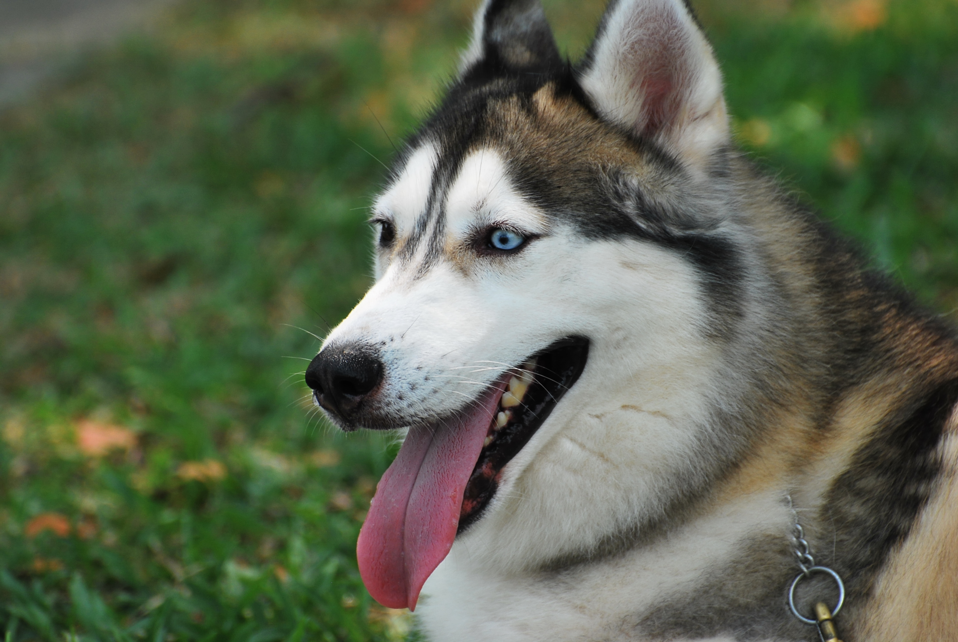
True or False?
Your pet will become overweight after spaying or neutering?
False. While it could potentially affect metabolism a little, by feeding a proper diet and including exercise in your pet’s daily routine, weight gain should not be a concern.
For more information on spaying and neutering, visit:
www.avma.org/public/PetCare/Pages/spay-neuter.aspx

