Slide 1
VTNE Review
Diagnostic Imaging (DXI)

Slide 2
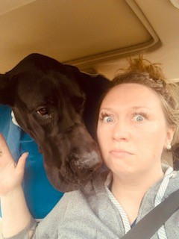
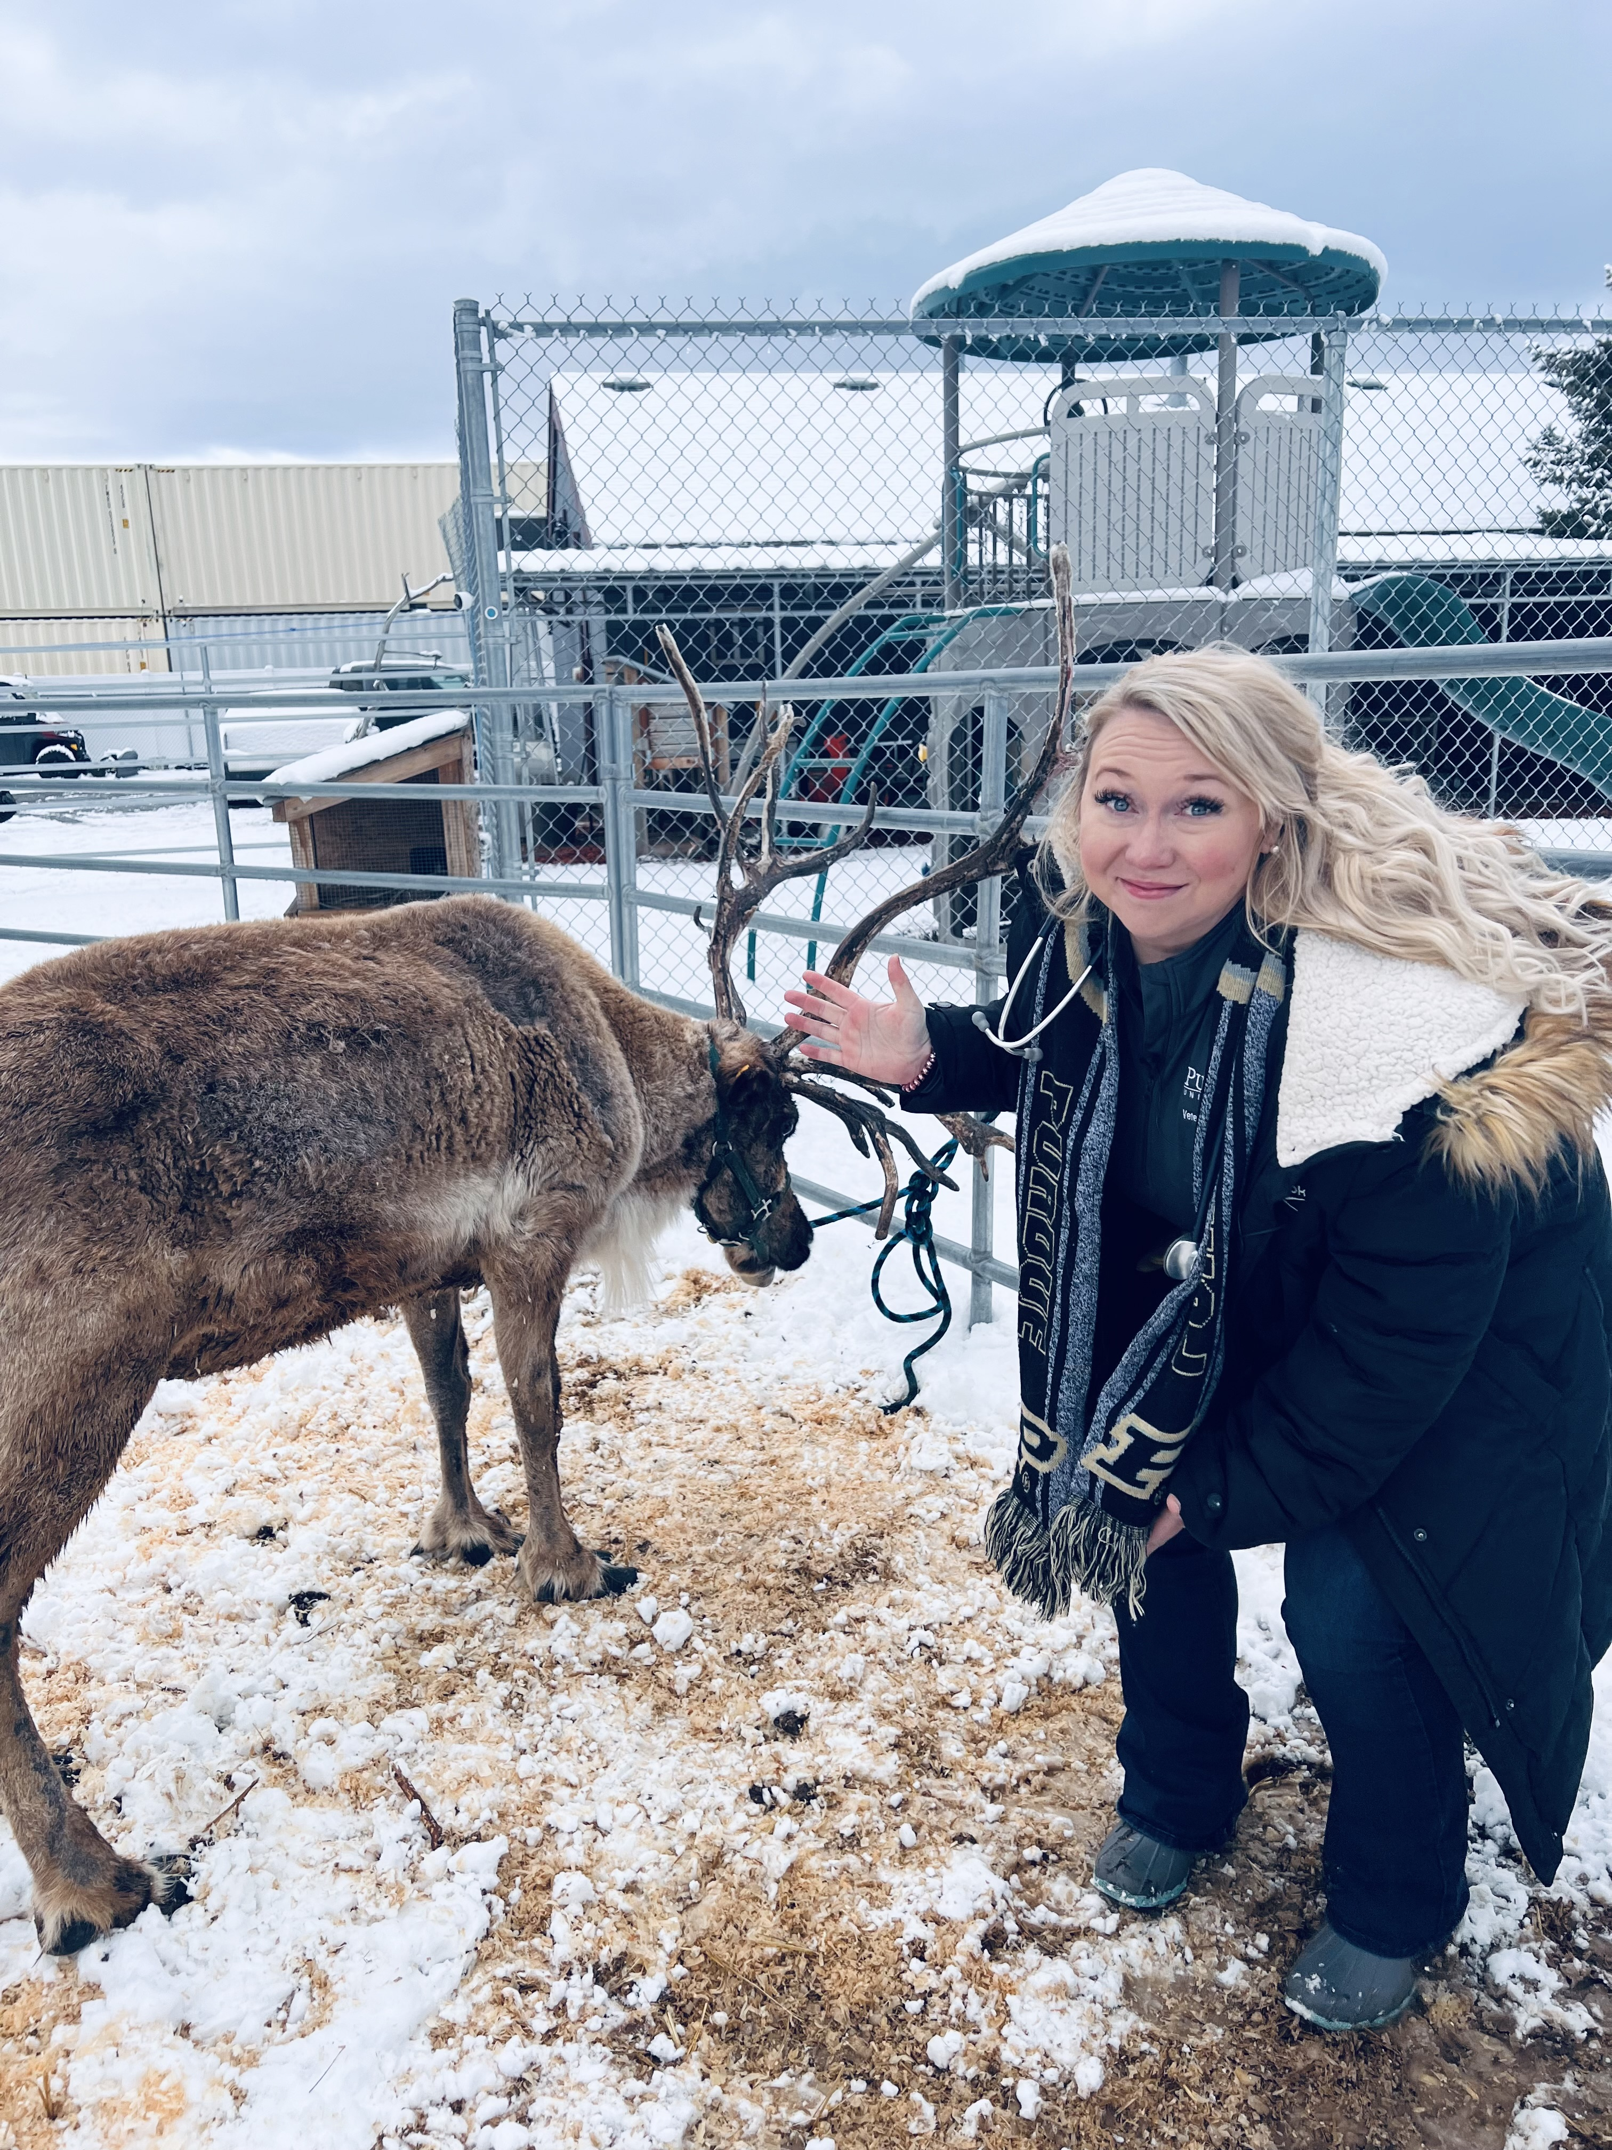
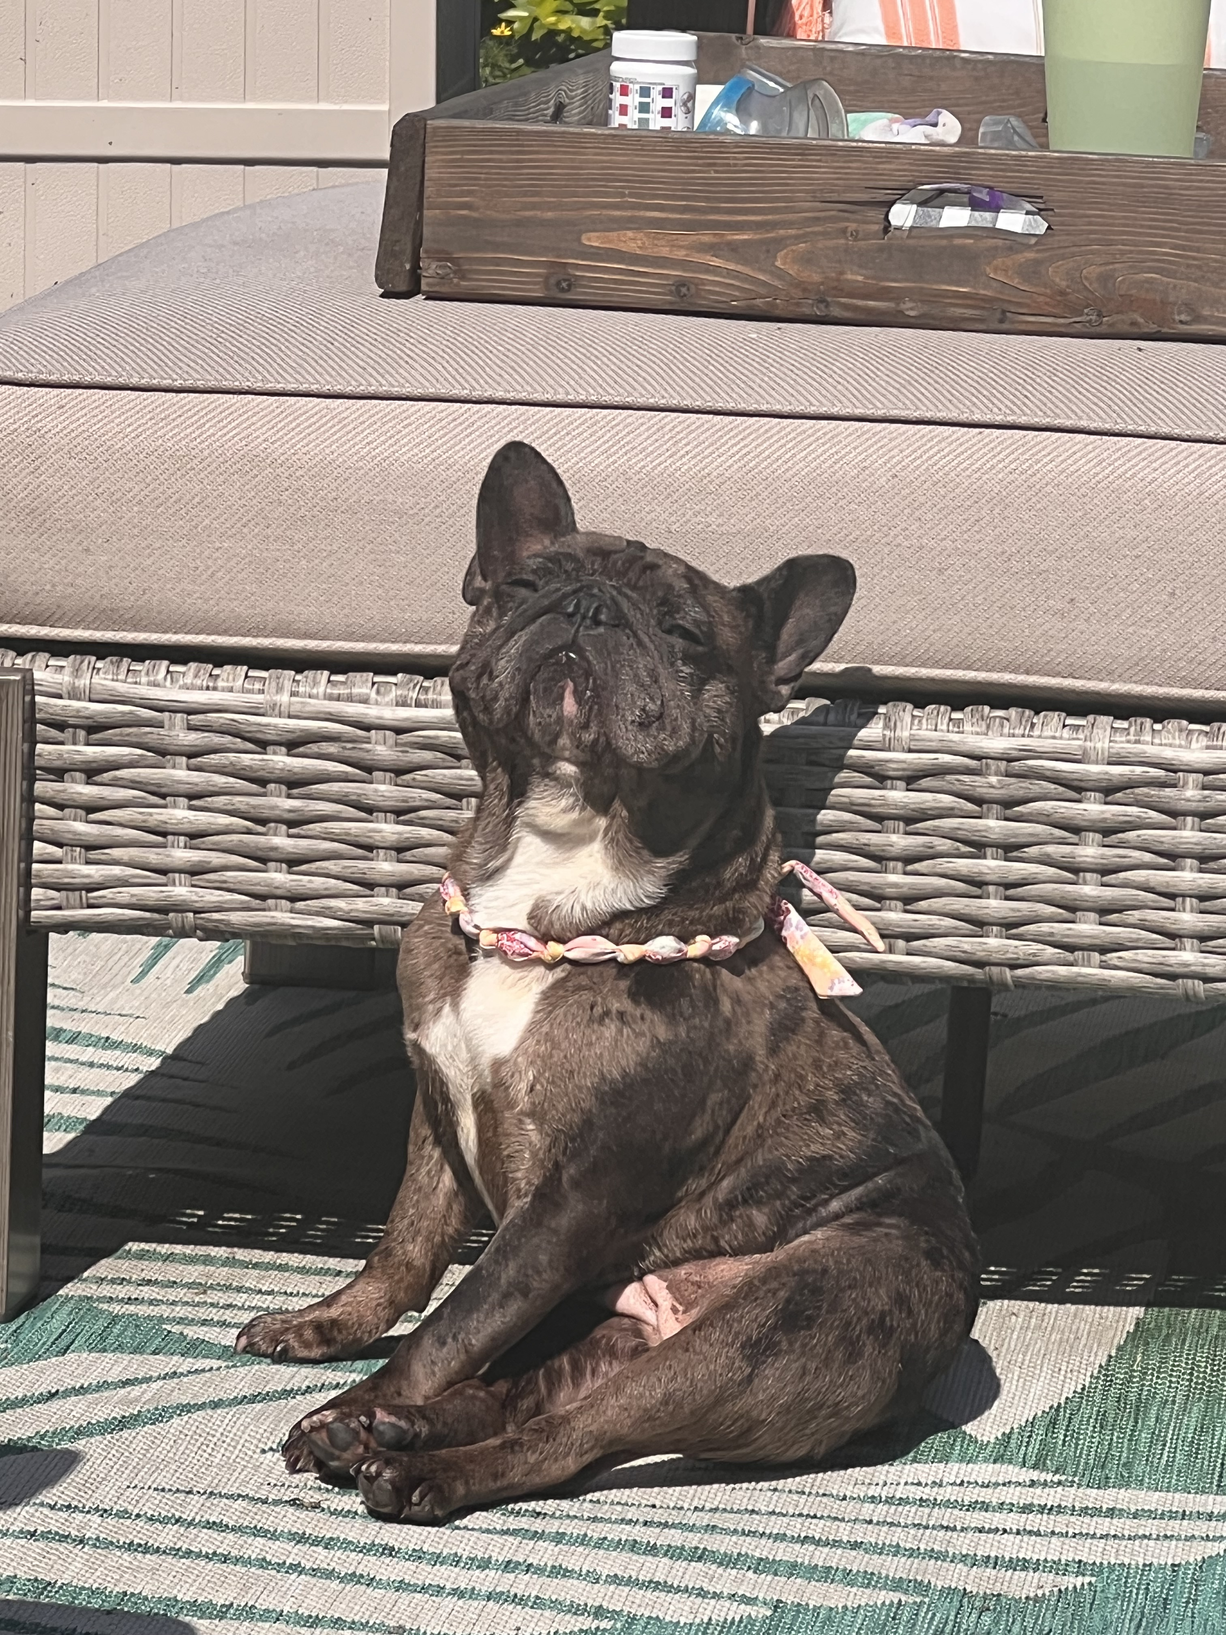
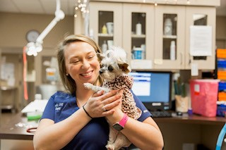
Ashli Selke RVT, CVT
NAVTA Immediate Past-President
IVTA President Elect
IVMEB board member

Slide 3
What are the landmarks for thorax radiographs? matching
Cranial-?
Center-?
Caudal-?

Slide 4
What are the landmarks for thorax radiographs? matching
Cranial- Manubrium Sterni
Center- Heart
Caudal- Curve of the last rib T13/L1

Slide 5
What two views are made when radiographing the thorax?
Mediolateral
Ventrodorsal
Lateral
Craniocaudal

Slide 6
What would your landmarks be when radiographing the metatarsus?
Hock to the digits
Carpus to the digits
Hock to the stifle
None of the above

Slide 7
What would the landmarks be when radiographing the stifle?
pelvis to the digits, centering on the joint
coxofemoral joint to the hock
mid femur to metatarsus, centering close to the joint
mid femur to mid tibia, centering on the joint

Slide 8
What are the landmarks for a radiograph of the radius and ulna?
carpus to shoulder
carpus to elbow
hock to stifle
shoulder to stifle

Slide 9
When radiographing the thorax, the exposure should be made at peak:
Expiration
Inspiration
it does not matter

Slide 10
What would your landmarks be when radiographing the femur?
stifle to the hock
coxofemoral joint to the stifle
carpus to the scapula
coxofemoral joint to the digits

Slide 11
What landmarks would you use when radiographing the humerus?
hock to the stifle
carpus to the elbow
shoulder to the elbow
carpus to the stifle

Slide 12
The veterinarian has made a lateral projection of the shoulder. What other view should you do to complete the study?
Craniocaudal
Dorsoventral
Caudocranial
Dorsopalmar

Slide 13
Before pushing the exposure button, you must make sure that____________?
image receptor/technique, grid/tray, is in position
the image is centered
all the above

Slide 14
The main principle of PennHip is to:
subjectively measure canine hip joint laxity
quantitatively measure canine hip joint irregularities.
quantitatively measure canine hip joint laxity.
subjectively measure canine hip joint irregularities.

Slide 15
DXI general question group

Slide 16
______________ is defined as the amount of time it takes the radioisotope to spontaneously/randomly decay.
half-life
gamma REMS
ALARA

Slide 17
The isotope that is most highly attracted to bone is:
iodine I 131
technetium Tc 99m
Uranium U 133
This Photo by Unknown Author is licensed under CC BY-SA

Slide 18
X-rays are generated when fast-moving collide with any form of matter.
Photons
Electrons
Anode
Grays
This Photo by Unknown Author is licensed under CC BY

Slide 19
What is used to produce the high voltage necessary on the anode side when accelerating electrons from the cathode to the anode?
Transformer
Filament
Generator
Rectifier

Slide 20
A focal film distance of how many inches is adequate to minimize the penumbra effect?
30-35 inches
12-15 inches
25-30 inches
36-40 inches

Slide 21
Occurs when an object is not parallel to the recording surface.
Distortion
Foreshortening
Foreshadowing
Penumbra
This Photo by Unknown Author is licensed under CC BY-SA

Slide 22
MRI question group

Slide 23
What part of the MRI machine is considered the most dangerous to anyone walking into the room?
the radio antenna
the magnet
the shim coils
the surface coils

Slide 24
What happens to atoms when they are placed in a magnet?
they move randomly
they reposition themselves with regard to their magnetic polarity
they shift to the north pole of the magnet

Slide 25
For which atoms are MRI radio frequencies tuned to in order to create images?
Helium
Carbon
Hydrogen
Oxygen
This Photo by Unknown Author is licensed under CC BY-SA

Slide 26
Contrast agents are most often used in CT for head, chest, abdominal and pelvic exams.
True
False
This Photo by Unknown Author is licensed under CC BY-SA-NC

Slide 27
Radiology question group

Slide 28
When radiographing the cervical vertebra, the area must be padded correctly to prevent what type of distortion?
Magnification
Foreshortening
False narrowing
Compression

Slide 29
What does OFA stand for?
Orthopedic Foundation of America
Organizational Followers of Arachnoids
Orthopedic Foundation of Arthritis
Orthopedic Foundation for Animals

Slide 30
What two views are standard for a skull series?
Left 30 degrees - right ventral oblique
Lateral
Frontal 90 degrees
Ventrodorsal

Slide 31
When looking at the finished radiograph, what criteria is used to show proper positioning for OFA? There may be more than one answer.
The femurs must be parallel to the table and one another.
There must be no overlap of the tuber ischii over the femurs.
The patella need to be positioned slightly lateral on the distal femur.
The widths of the iliac shaft must be equal.

Slide 32
Where do you measure for the kVp setting when radiographing the ventrodorsal thoracic vertebra?
Illium
Xiphoid process
Highest point
Manubrium sterni

Slide 33
What is the cranial landmark for a ventrodorsal view of the pelvis that will be sent for OFA certification?
Wings of the atlas
Wings of the ilium
Stifle joints
T-13/L-1

Slide 34
When positioning for a frontal 90 degrees view of the skull, what area will be isolated?
Calvarium
Sagittal crest
Frontal sinuses
Coronoid process of the mandible

Slide 35
Ultrasound question group

Slide 36
During the recording of an abdominal ultrasound image, which side of the monitor should the cranial quadrant be displayed on a sagittal view?
the far field of the image screen
the left side of the screen
the near field of the image screen
the right side of the screen

Slide 37
How does the waveform of ultrasound compare to audible sound?
Ultrasound has a shorter wavelength.
Ultrasound has a longer wavelength.
Ultrasound has the same wavelength.

Slide 38
What frequency of sound does ultrasound utilize?
High frequency sound waves
Low frequency sound waves
Mid frequency sound waves

Slide 39
Horse talk😊

Slide 40
What is the importance of elevating the contralateral limb of a horse when radiographing the distal phalanx?
So there will be more weight on the limbs not being elevated.
To help prevent the horse from striking.
To insure proper weight distribution.
To make it easier to visualize the position of the foot.

Slide 41
For a Dorsoproximal-Palmarodistal oblique view (Upright pedal) of a horse you want to center the primary beam over the distal phalanx.
True
False

Slide 42
What is the purpose of angling the beam 20 degrees when radiographing the metacarpophalangeal joint for a Dorsopalmar view of a horse?
Enables the technician to see the limb easier when positioning the x-ray tube.
More even weight distributes of the x-ray tube.
Projects the sesamoids above the metacarpophalangeal joint space.
Positions the sesamoids over the joint space.

Slide 43
Which view allows the medial sesamoid to be visualized without the lateral sesamoid bone superimposed on a horse?
Dorsolateral-Palmaromedial oblique view
Lateromedial view
Dorsomedial-Palmarolateral oblique view
Dorsopalmar view

Slide 44
Which view allows the palmar surface of the navicular bone to be visualized on a horse?
Palmaroproximal-Dorsodistal oblique view (Caudal Tangential)
Lateromedial view
Dorsoproximal-Palmarodistal oblique view (Upright Pedal)
Dorsopalmar view

Slide 45
It is not important to label fetlock radiographs with both left and right markers as well as front and rear markers on horses.
True
False

Slide 46
A true Lateromedial view of a horse:
Displays the metacarpal condyles and superimposed sesamoids with a visible joint space.
Allows the lateral sesamoid to be visualized without the medial sesamoid bone superimposed.
Allows the medial sesamoid to be visualized without the lateral sesamoid bone superimposed.
Projects the sesamoids above the metacarpophalangeal joint space.

Slide 47
Which of the following would not cause an artifact on the finished radiograph?
Horseshoes
Untrimmed/uncleaned hoof
Air in the sulcus
Modeling clay in the sulcus

Slide 48
Which view allows a clear view of the Dorsolateral and Palmaromedial surfaces of the carpal bones on a horse?
Dorsolateral-Palmaromedial oblique view
Flexed Lateromedial view
Lateromedial view
Dorsomedial-Palmarolateral oblique view

Slide 49
How would you describe the caudal aspect of the right rear limb of a horse’s foot?
Palmar
Plantar
Distal
Rostral

Slide 50
Film and Screen

Slide 51
What is film latitude?
The film's ability to be displayed.
The film's ability to produce many shades of gray
the film's size
the film's speed

Slide 52
The gelatin that suspends the silver halide crystals in the emulsion liquefies in warm temperatures. Why is this important?
Because it allows the processing chemistry to interact with all the suspended silver halide crystals in the emulsion.
Because it allows the silver halide crystals to be exposed to the x-ray energies.
Because it allows the emulsion to be removed from the film.
Because it keeps the processing chemistry from damaging the silver halide crystals.
This Photo by Unknown Author is licensed under CC BY

Slide 53
How should film be stored?
in a cool dry place
in a place with low humidity
set the boxes end on and not flat on their sides
all of the above
None of the above

Slide 54
When the silver halide crystals are exposed to electromagnetic radiation they become susceptible to chemical change. What is the image called at this time?
Radiograph
image want to be
latent image
early image

Slide 55
What kind of artifact is caused from periodically removing the film from the developer tank to see if it has enough radiographic density?
emulsion slippage
periodic development
total development
sight development

Slide 56
When do scratches usually occur?
before processing
during processing
after processing when it is dry
in the film box

Slide 57
Why does poor film-screen contact decrease the detail in that area?
Because the mAs should have been increased.
Because the decrease distance between the film and screen does not allow the light from the intensifying screen to diverge before hitting the film.
Because the increased distance between the film and screen allows the light from the intensifying screen to diverge before hitting the film.
Poor film-screen contact increases the detail of the image.

Slide 58
How does the developer affect the silver halide crystals in the films emulsion?
It causes the silver halide crystals to fluoresce.
It changes the sensitized silver halide crystals into black metallic silver.
It changes the unsensitized silver halide crystals into black metallic silver.
It changes all the silver halide crystals into black metallic silver.

Slide 59
Why is it important to wash a film completely after fixing?
Because the fixer remaining on the film will oxidize over time and turn brown.
Because the developer remaining on the film will oxidize and turn brown over time.
Because the fixer remaining on the film will solidify over time.
none of the above

Slide 60
What can be caused from leaving a film in the wash water too long?
brown films
emulsion slippage
dark spots
fogged film

Slide 61
How will a radiograph look that has been processed in chemicals that are colder than the manufacturer recommends?
increased radiographic density and decreased contrast
overall gray appearance, gray swirly background
brownish color
too dark

Slide 62
What does a radiograph that has been fogged look like?
background will be swirly
many white spots in the background
overall gray appearance
just fine

Slide 63
The film has been in the developer. What happens to the film when it is placed in the fixer?
The fixer changes the sensitized silver halide crystals into black metallic silver.
The fixer removes all the remaining silver halide crystals.
The fixer changes all the desensitized silver halide crystals into black metallic silver.
The fixer turns the film different colors.

Slide 64
Rough handling of the film can cause:
an overall gray appearance
black crescents
brown films
nothing

Slide 65
PPE

Slide 66
Lead gloves should be worn to protect the hands from primary beam exposure.
True
False

Slide 67
Which of the cumulative effects of radiation cause damage to the body within the lifetime of the individual?
genetic effects
carcinogenic effects
stomotomatic effects
somatic effects

Slide 68
It is a good idea to drape the lead gloves over your hands instead of wearing them when dealing with difficult patients.
True
False

Slide 69
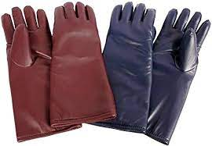
Lead gowns and gloves should be radiographed to check for:
proper lead thickness
damage to the vinyl
check to see if the seams have been torn
cracks in the lead

Slide 70
Lead gloves and aprons should contain at least:
.05 mm lead equivalent
.5 mm lead equivalent
.65 mm lead equivalent
1 mm lead equivalent

Slide 71
Which of the following is the maximum permissible dose;
500 mREM
50 REM
5 REM
.5 mREM

Slide 72
Why should the film badge be worn at the collar level?
monitor primary beam exposure
monitor exposure to the thyroid and lenses of the eyes
monitor radiation collected in the room
monitor scatter radiation that bounces off the table

Slide 73
Which terminology would be used when trying to keep exposure as low as reasonably achievable.
ALANIS
REM
ALARA
MRLM

Slide 74
mAs and Kvp question group

Slide 75
Film fogging (increases/decreases) the radiographic contrast?
Increases
Decrease radiographic contrast by decrease differences in densities between two adjacent shadows.
Decreases
Decrease radiographic contrast by decrease differences in densities between two adjacent shadows.

Slide 76
Define radiographic density.
many greys
degree of blackness
object not parallel to the film
degree of whiteness

Slide 77
A blurring at the tissue interfaces can be caused by:
false narrowing
increased radiographic density
penumbra effect
short scale of contrast

Slide 78
How does mAs effect the scale of contrast?
increased mAs = long scale of contrast
decreased mAs = long scale of contrast
increased mAs = short scale of contrast
no effect

Slide 79
How does kVp effect the scale of contrast?
increased kVp = long scale of contrast
decreased kVp = long scale of contrast
increased kVp = short scale of contrast
no effect

Slide 80
Changing the mAs will affect the (quality/quantity) of the x-rays generated?
Quality
Quantity
This Photo by Unknown Author is licensed under CC BY-SA

Slide 81
An exposure made with 15:1 ratio grid would require a higher mAs than an exposure made with a 8:1 radio grid.
True
False

Slide 82
What makes up the latent image?
Sensitized silver halide crystals
Combination of Rare Earth screen plus KVP setting
Fixer
Developer

Slide 83
If a radiograph was taken first at 10 mAs and 100 kVp, and a second was taken at 12 mAs and 50 kVp, will the second radiograph have an increased, decreased, or the same radiographic density as the first?
Decreased
Increased

Slide 84
What is the purpose of a moving grid?
To create gridlines
To erase gridlines
To divide and conquer

Slide 85
What happens to the x-ray tube if the mAs and kVp are both set too high?
Glass envelope shatters
Tube overload, causing too much heat which causes a crack in the anode
Tube saturation, causing too many electrons to scatter
Nothing

Slide 86
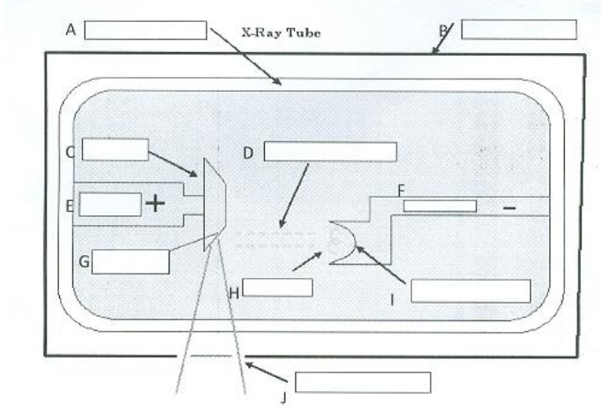
Name the different parts of the Xray Tube
A.
B.
C.
D.
E.
F.
G.
H.
I.
J.

Slide 87
Name the different parts of the X-ray Tube
A. Glass Envelope
B. Metal Housing
C. Rotating Anode
D. Accelerating Electrons
E. Anode
F. Cathode
G. Tungsten Target
H. Filament
I. Focusing cup
J. Beryllium Window or Primary Beam

Slide 88
Utilizing correct directional and anatomical terminology identify the view

Slide 89
Utilizing correct directional and anatomical terminology identify the view
Ventrodorsal Abdomen

Slide 90
Identify the labeled anatomical structures.
____________
____________
____________
____________
____________
1
2
3
4
5

Slide 91
Identify the labeled anatomical structures.
Liver
Stomach
Spleen
Small intestine
Colon
1
2
3
4
5

Slide 92
Identify the radiographic view in the image below using correct directional and anatomical terminology.

Slide 93
Identify the radiographic view in the image below using correct directional and anatomical terminology.
Right Dorsoplantar tarsus/hock

Slide 94
Identify the following contrast study.
Positive Contrast Cystography
Upper Gastrointestinal Series
Excretory Urography
Myelography

Slide 95
Identify the dental arcade being isolated in this image.
Left maxilla
Right maxilla
Right mandible
Left mandible

Slide 96
Identify the following radiographic view.
Dorsopalmar view of the metacarpus
Lateromedial view of the metacarpophalangeal joint
Dorsopalmar view of the metacarpophalangeal joint
Dorsoplantar view of the tarsal joint

Slide 97
Radiolucent appears black on a radiograph
True
False
This Photo by Unknown Author is licensed under CC BY-NC

Slide 98
Abdominal radiographs are exposed during:
Inspiration
Expiration
half way between inspiration and expiration
does not matter

Slide 99
What are the landmarks for the abdomen?
Cranial-?
Center-?
Caudal?

Slide 100
What are the landmarks for the abdomen?
Cranial-3 rib Spaces cranial to the xyphoid
Center-Last rib
Caudal- Greater Trochanter
This Photo by Unknown Author is licensed under CC BY-SA-NC

Slide 101
Collimation allows for: (select all the correct answers)
enhanced radiation safety
professional images
improved image quality
maximum electron voltage
speedy radiographs

Slide 102
Match the following contrast studies with the appropriate organ system.
Pneumocystography--
Upper gastrointestinal series—
Excretory urography–
Myelography–
Urethrography-
Subarachnoid Space
Kidneys
Urethra
Jejunum
Urinary Bladder

Slide 103
Match one of the list below with the statements.
Neither slow nor high—
High speed screens—
Slow speed screens—
—higher detail, smaller crystals +requires more radiation/density
—larger crystals, less detail
—longer scale of contrast

Slide 104
List three ways to reduce exposure to radiation.

Slide 105
List three ways to reduce exposure to radiation.
Decrease time
Increase distance
PPE

Slide 106
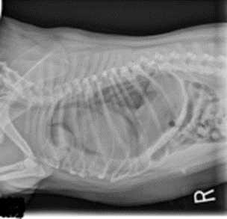
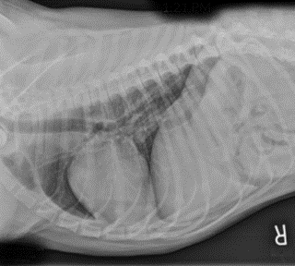
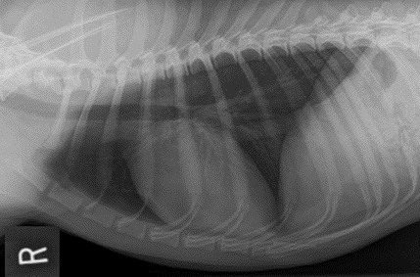
Using the CALIPER acronym choose the thoracic radiograph of best diagnostic quality.
A
B
C.A.L.I.P.E.R.
C. Collimation
A. Artifact
L. Landmarks
I. Identification
P. Positioning
E. Exposure
R. Radiographic Presentation
C
D

Slide 107
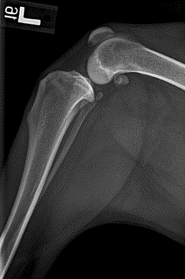
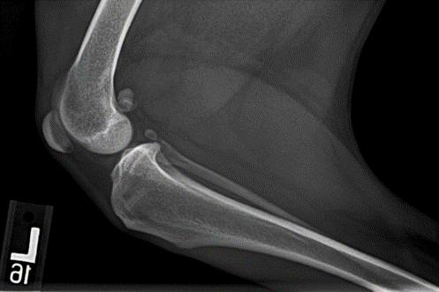
Which radiograph is properly hung or presented?
A
C
B
D

Slide 108
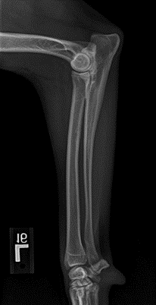
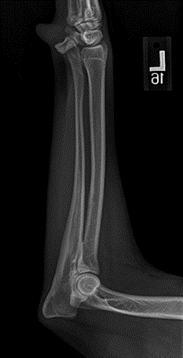
Choose the extremity radiograph that is properly hung or presented.
A
B
D
C

Slide 109
The End!
This Photo by Unknown Author is licensed under CC BY-NC-ND

